Slide 1
LECTURE # 05 SITE ANALYSIS FACTORS

Slide 2
Site Analysis Factors
The analysis of the site and its environs includes various factors and features that affect it.
These factors influence final site selection and provide clues in establishing guidelines for later development.
Broadly these factors are categorized as:
1. Natural Factors
2. Biological Factors
3. Cultural/Aesthetic Factors

Slide 3
CULTURAL/AESTHETIC FACTORS

Slide 4
Site Inventory CULTURAL/AESTHETIC Factors
Categories | Attributes
Landuse/Socio-Economic Factors | Prior/existing landuse Landuse on adjoining properties Off-site nuisance Socio-Economic factors
Legal/Regulatory Factors | Political boundaries Land ownership Landuse regulations Easements & deed restrictions Density & Zoning
Utilities | Water Sanitary & storm sewer Electricity Gas Telecommunication

Slide 5
Site Inventory CULTURAL/AESTHETIC Factors
Categories | Attributes
Traffic/Circulation | Street function (e.g., arterial or collector) Vehicular & pedestrian circulation on or adjacent to site Traffic volume
Buildings | Buildings and landmarks Historical/Archeological sites
Aesthetic/Sensory Factors | Visibility Visual quality Noise Odors

Slide 6
1. landuse/ socio-economic factors
The pattern of existing land use must be studied in relation to the site and adjacent areas.
Community facilities, residential, commercial, industrial and recreational areas are inventoried to find out overall trends of development.
Site planner should meet the adjacent property owners to find out the trends of future development.

Slide 7
Off-site nuisance
Off-site nuisance – whether visual, auditory or olfactory – and safety hazards must be investigated.
If one or more of these problems is uncontrollable, an alternative site may have to be chosen.
Among visually disruptive elements are:
Power lines,
Water towers,
Certain industrial complexes,
Highways,
Billboards, and
Junkyards

Slide 8
Off-site nuisance
Possible auditory nuisances include:
Heavy automobile,
Rail and Air traffic,
Noise made by large number of people
Olfactory nuisances originate in:
Dumps,
Chemical and other wastes
Safety hazards result from the:
Lack of linkages in areas of heavy traffic
Severe/sudden changes in land, such as steep cliff at the edge of a site,
Air pollution caused by traffic in congested areas.

Slide 9
Site linkages
Linkages may involve the movement of people, goods, communication or amenities.
While studying the location of the site and the existing land use of adjacent properties, all existing linkages should be analyzed and investigated.
Determine whether adequate linkages exist, if not, decide how they can be established or improved.

Slide 10
Socio-economic factors
The study of a community and its social and economic structure is important in determining the feasibility of a project.
Important concerns might be:
Who is the user of the project?
Are the user’s needs being addressed?
What does the community and neighborhood around the site look like?
Social factors such as population, intensity, educational level, economic & political factors, ethnicity, cultural-typology etc, have a broad range of effects on community facilities and services.

Slide 11
Socio-economic factors
Community standards and expectations are usually unwritten and often ambiguous, but still they are very important.
Standards for architectural elements, vehicles circulation, etc. are all standards and expectations that often exceed written ordinances.
A community interest that might be impacted by a project might cause resistance to the project proposal.

Slide 12
Local sources of Socio-economic data
Local sources of data on socio-economic factors might be:
Planning Commission
Census Organizations
Economic surveys
Utility services companies
Statistics divisions, etc.

Slide 13
2. legal/ regulatory factors
Density – an important sociological and legal element – is expressed in number of families or dwelling units per acre in residential development.
Density may influence privacy, freedom of movement, or social contact among people.
Site boundaries can be located by either verifying the dimensions physically or through map records of land development departments.
Height restrictions, ground coverage, floor area ratio (FAR), parking requirements could be obtained from development plans.
Zoning classifications from a zoning map to be procured from the city planning department.

Slide 14
zoning
Zoning provide an overview of the community’s vision itself showing:
Not only how a site may be developed or used,
But also how surrounding sites might be.
Zoning regulations concerned density standards because of economic, social and functional implications.
Zoning regulations may contain design criteria such as plot sizes, setbacks, road widths, etc.

Slide 15
Overlay zones
Zoning may include overlay zones that have important implications for land use.
Overlay zones may include:
Steep slope restrictions
Watershed protection
Historic preservations, or
Aquifer protection zones
These may severely limit land development activities and require a high order of performance from the design, construction and operation of a site.

Slide 16
3. utilities
All utilities located on or adjacent to the site under study should be shown graphically for consideration in site development.
Utility companies should be contacted early in the site planning process to see if project needs can be met.
Generally, utilities are located in open areas adjacent to streets or under streets for easy maintenance.

Slide 17
Utilities mapping
Identifying location of utilities is made possible using maps provided by local utility companies.
The use of GIS can help to provide reasonably accurate utility data in most places.
Location of utility services should be confirmed in the field for design purposes.

Slide 18
Potable water
Water is the most crucial utility for growth at the community level.
There are several types of distribution systems, most commonly are:
Gravity from a reservoir, and
Direct pressure
Normally, water lines are located adjacent to roads where they can be services easily.
Size requirements for water supply mains is 6 inches min for residential areas and 8 inches for high value areas.
User need for water varies from 50 to 75 gallons per person per day in cities.

Slide 19
Sanitary sewers
Sewage is usually disposed off in system separate from rain/storm water.
The minimum size of sewer pipe is generally 8 inches for mains and laterals and 6 inches for house branches.
Poorly drained soils or soils with a high water table are not suitable for septic systems.
Grade over 15% and the bedrock close to soil surveys also limit the use of septic systems.

Slide 20
Rain/storm water
Rain/storm water system pick up surface water and carry it to local water bodies.
Storm pipe is often a minimum of 15 inches with manholes 300 to 500 feet apart.
Catch basins are either placed in roads or adjacent to road edges.

Slide 21
Electric power
Traditionally, power poles about 120 feet apart are placed along streets with overhead wires.
Electricity wires are placed underground in high value areas.
Underground electricity distribution is about 3 times more expensive.

Slide 22
telephone
Telephone lines are either placed overhead or on electric power poles or are placed separately on telephone poles.
These lines are also placed in underground conduits.

Slide 23
gas
Gas is piped in an underground system similar to water distribution.
Gas transmission lines have pressure ranging from 100 to 500 pound per square inch (psi) while service pressures range from 10 to 100 pound per square inch (psi).
Pipe sizes varies from 12 to 36 inches for transmission and 1¼ to 20 inches for high and medium pressure distribution.

Slide 24
4. Traffic and transit
The important considerations towards the traffic and transit are:
What is the relationship of traffic patterns to the site?
Are there adequate roads in the vicinity?
If the site is urban, does public transportation serves the area? etc.
Depending on the complexity of the problem, automobile, bus, railroad and air circulation should be reviewed and integrated to future site development.

Slide 25
Studies for Traffic and transit
Important studies will be:
Inventorying existing vehicular networks,
Trips origin, destination, purpose, time of day, and volume,
Location and availability of routes,
Forecasted no. of trips and parking requirements,
Traffic volume, etc.
If site is located near the airport (within 15 miles), check noise zones and building height restrictions also.

Slide 26
5. buildings
Existing buildings strongly influence the physical layout of the new site plan, especially when the project is the expansion of the existing buildings.
Type, size, floor area, existing conditions and their uses and facilities must be studied.
Existing buildings must be shown graphically and they will also help to establish the drainage pattern on the site.
Existing buildings may determine the choice of future architectural expression in building type, color, façade, texture, materials, window type and roof style to ensure coherence and unity in design.

Slide 27
Historic/archeological sites & buildings
The historic and archeological elements of a site are very important and should be preserved.
Discovering that a site has a historical feature or value is a critical piece of data in the early analysis.
Sometimes local names for features such as bridges and roads might be indicators of some historical or cultural element of value.
Local historic and cultural values are sometimes hard to discern.
Historical buildings, archeological sites, and landmarks should be marked on maps.

Slide 28
brownfields
Brownfields are abandoned or underutilized properties that are environmentally impacted or are perceived as being impacted from past industrial or commercial activities.
Such sites may present a planner with a wide range of unfamiliar site restrictions and conditions.
Site planning on such sites must address the contamination or the mitigation strategy selected to protect the users and the environment.

Slide 29
5. aesthetic/sensory factors
Sites on which future development is planned must be analyzed to determine significant aesthetic factors.
Aesthetic factors include:
Natural features, and
Spatial patterns
The character of many sites is distinguished by the arrangements of these elements.

Slide 30
Natural features
Sites must be analyzed for outstanding natural features of earth, rock, water or plant material.
Landforms, rock outcrops, lakes, streams, bogs or wooded areas have scenic value and may be incorporated in development.
The attempt should be to use these elements as advantage rather than reducing their impact through improper site treatment.

Slide 31
Spatial pATTERNS
Spatial pattern is defined as the way an open space of a given site is configured according to an arrangement of elements that evoke activity or flow, both physically or visually.
Spatial patterns include:
Views
Visual barriers
Vistas

Slide 32
views
Views on a site may be pleasing or objectionable.
An outstanding view must be handled properly to be preserved.
Important concerns may be:
Do the views seem static?
Do they attract attention and draw movement toward them? etc.
A view is completely revealed only from its best vantage point.
Views on a site must be compatible with proposed activities and their relation to each other because nuisances both on or off site may disrupt them.
Types of views can be framed, open, enclosed, filtered, and screened.

Slide 33
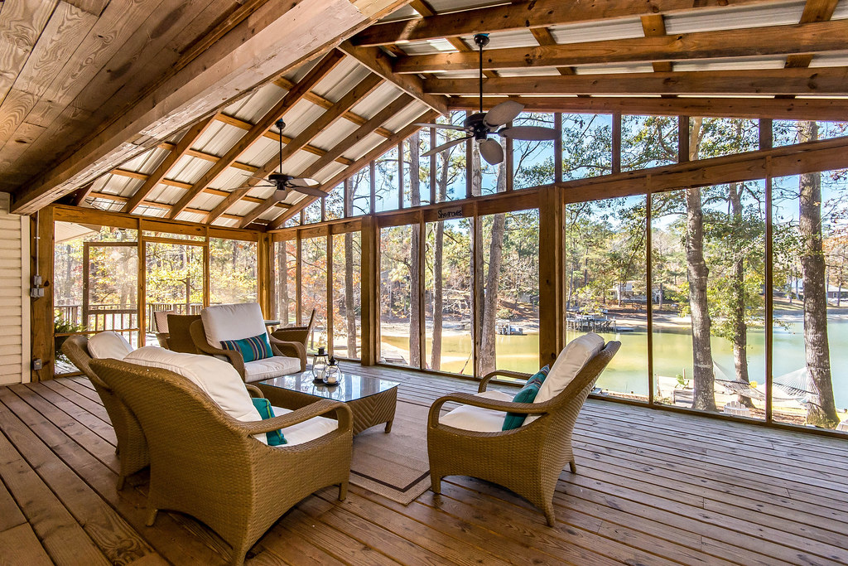
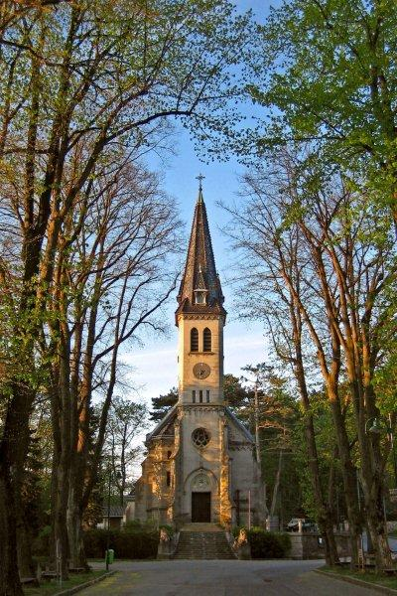
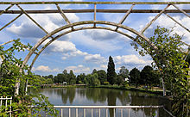

Slide 34
Visual barriers
Visual barriers such as an elevated highway or vegetation cut off views of a part of a community or a natural feature.
These barriers should be used to screen objectionable views only and not the potential views.

Slide 35
Vistas
A vista may be a natural or completely man-made view.
It has a dominant focal point that is strongly emphasized and is balanced by minor elements forming masses to enclose the vista.
The open space or line of the vista is a strongly directional element leading the observer toward the focal point for closer observation.

Slide 36
Some generalized guidelines
Variety of entrances are desirable in order to avoid chaos or interference.
Institutional structures should have strong emphasis on visual setting in an expressive way.
Future requirements for land area may be computed from the floor space requirements i.e. density or floor area ratio, still they vary widely from institution to institution.
Open spaces are also desirable for visual amenity, recreation and future growth.

Slide 37
Some generalized guidelines
High rise structures may be preferred in order to reduce the time distances between activities.
Problem of parking may become more difficult because of the various group of users.
In order to keep the environment quiet and peaceful, longer walking distances may be imposed from parking lots to destinations.
Approaches of pedestrianization and parking charges may also be imposed.

